Slide 1
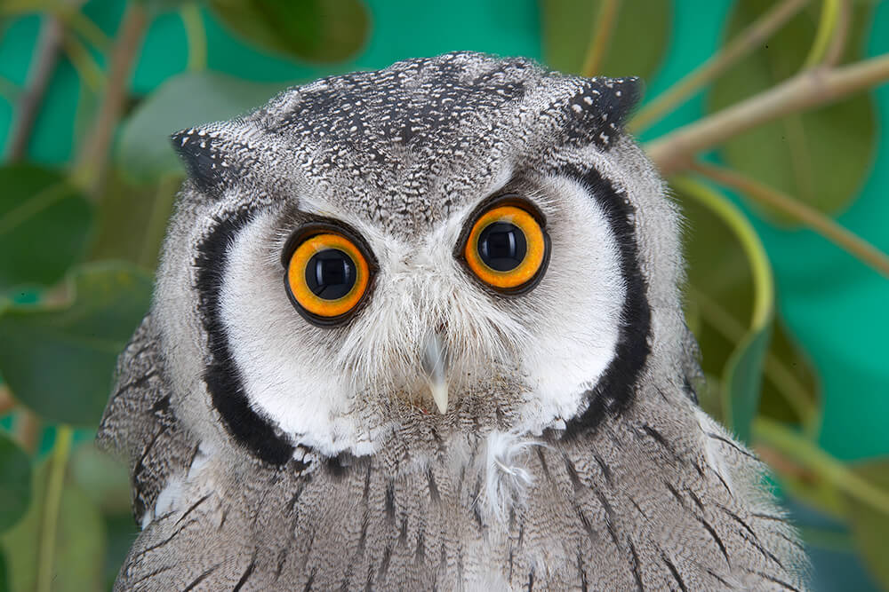
GRAY OWLS GROUP
Experiments on multiple sorting algorithms

Slide 2
Our Goals
Introducing our project
Stating the problem
Informing on the importance of this experiment
Stating what we want to achieve with the results
Sharing our methodology
Reporting the results of the experiments

Slide 3

Our Project
Simple app that finds places that are close to the user (Like suicide hotspots).
Big deal, because nobody has thought about this before and developing new apps is lucrative.

Slide 4

The problem (Everyone`s got one. Don’t judge us)
Insertion sort? Quick sort? Merge Sort?
“Many algorithms that have the same efficiency do not have the same speed on the same input.” (Alex Allain, 2011)
Input type: float Nature of array: KNOWLEDGE ERROR
Which algorithm will yield the best results? That is what we want to find out.

Slide 5
The Experiment
How does Insertion Sort perform under these conditions?
How does Quick Sort perform under these conditions?
How does Merge Sort perform under these conditions?
Which Algorithm would be most suitable for our app?

Slide 6
The methods we used
We input user`s coordinates
Starting from 50 to 1000 with a 50 increment length array.
Operating System: Windows 10
Compiler: Dev C++ 11
Language: C++
Chrono Library ( to measure in nanoseconds )
Establishment ID | X coordinate | Y coordinate
McDonalds (Uskudar) | 16499.032400 | 20330.123100
Simit Sarayi (Uskudar) | 9737.778500 | 15131.786500
Martian King (Mars) | 8091.101100 | 18428.707500

Slide 7
Insertion Sort
O(n^2)
n | Time(s)
50 | 0.001688
100 | 0.00171
150 | 0.001723
200 | 0.001792
250 | 0.002012
300 | 0.002195
350 | 0.00221
400 | 0.002258
450 | 0.002321
500 | 0.002322
550 | 0.00233
600 | 0.00245
650 | 0.00244
700 | 0.00249
750 | 0.00301
800 | 0.00315
850 | 0.00324
900 | 0.00349
950 | 0.00359
1000 | 0.0038

Slide 8
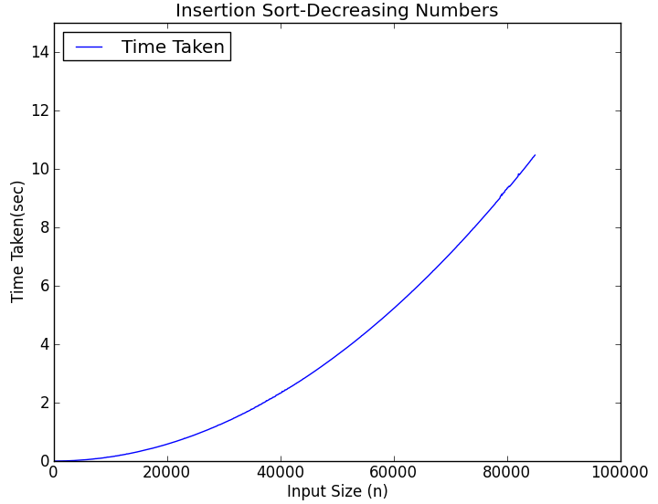

Slide 9
Quick Sort
Ω(nlogn)
n | time(s)
50 | 0.001036
100 | 0.001052
150 | 0.001254
200 | 0.001349
250 | 0.001592
300 | 0.001687
350 | 0.001646
400 | 0.001694
450 | 0.001612
500 | 0.001587
550 | 0.001798
600 | 0.001644
650 | 0.001758
700 | 0.001879
750 | 0.002019
800 | 0.002012
850 | 0.002306
900 | 0.002351
950 | 0.002481
1000 | 0.002544

Slide 10
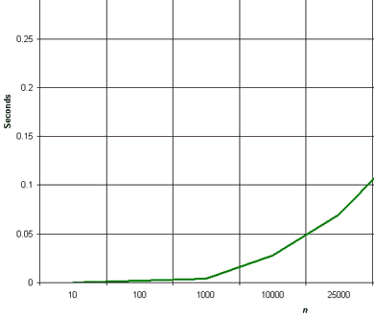

Slide 11
Merge Sort
O(nlogn)
n | Time
50 | 0.000084587
100 | 0.000153883
150 | 0.000218547
200 | 0.000311127
250 | 0.000414855
300 | 0.000522095
350 | 0.000539525
400 | 0.000793608
450 | 0.000951718
500 | 0.001013278
550 | 0.001331433
600 | 0.00115539
650 | 0.001576227
700 | 0.002008246
750 | 0.002060845
800 | 0.002279553
850 | 0.002864868
900 | 0.002975666
950 | 0.003255761
1000 | 0.003512831

Slide 12
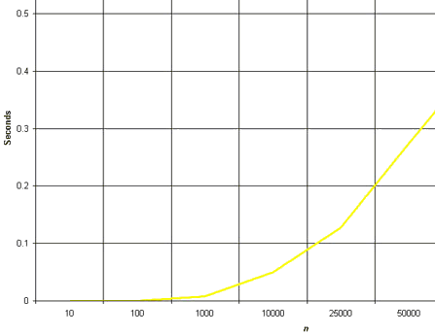

Slide 13
Altogether

Slide 14
Conclusions
This project will definitely make us all rich.
Stimulate our country`s economy.
Free advertising.
Merge Sort when < 650
Quick Sort when >= 650
NO INSERTION SORT ( BAD BAD BAD )
Experiment was worthwhile.

Slide 15

THE END
THANK YOU

Slide 16
References
CITATIONS
http://www.cprogramming.com/tutorial/computersciencetheory/sortcomp.html
http://searchengineland.com/figz/wp-content/seloads/2014/08/maps-local-search1-ss-1920-800x450.jpg
https://upload.wikimedia.org/wikipedia/commons/d/d5/Insertion_sort_graph.png
http://www.personal.kent.edu/~rmuhamma/Algorithms/MyAlgorithms/Sorting/Gifs/quickGraph.gif
http://www.personal.kent.edu/~rmuhamma/Algorithms/MyAlgorithms/Sorting/Gifs/mergeGraph.gif
PICTURES

